Slide 1
Stage 1
Understand The Data

Slide 2
Churn Rate
Churn rate / rate of attrition / customer churn, yaitu tingkat di mana pelanggan berhenti menggunakan layanan atau produk dari suatu entitas. Churn rate paling sering dinyatakan sebagai persentase pelanggan yang menghentikan penggunaan layanan atau produk mereka dalam jangka waktu tertentu.
Customer churn sangat penting karena bisnis akan rugi besar jika kehilangan pelanggan. Berdasarkan penelitian, biaya untuk mendapat pelanggan baru 5 kali lebih mahal daripada mempertahankan pelanggan yang sudah ada, dan membuat pelanggan baru menjadi loyal juga 16 kali lebih mahal. Jadi, diperlukan strategi untuk menghentikan customer churn dan meretensi pelanggan yang sudah dimiliki, karena pelanggan adalah sumber utama revenue bisnis

Slide 3
Customer Dataset
 | CustomerId | Surname | CreditScore | Geography | Gender | Age | Tenure
Data Type Range Description | Integer - ID Pelanggan | String - Nama Pelanggan | Integer 350 – 850 Skor Kredit Pelanggan | String - Negara Domisili Pelanggan | String - Jenis Kelamin Pelanggan | Integer 18 – 92 Umur Pelanggan | Integer 0 – 10 Jangka Waktu Kredit (tahun)
 | Balance | NumOfProducts | HasCrCard | IsActiveMember | EstimatedSalary | Exited
Data Type Range Description | Integer 0 – 251.000 Saldo yang dimiliki | Integer 1 - 4 Jumlah Produk Yang Digunakan Pelanggan | Boolean 0 - 1 Apakah Pelanggan Memiliki Kartu Kredit Atau Tidak | Boolean 0 – 1 Apakah Pelangan Aktif Dalam 1 Bulan Terakhir | Integer 11.600 – 200.000 Perkiraan Gaji Pelanggan | Boolean 0 – 1 Apakah Masih Tercatat Sebagai Pelanggan Atau Tidak

Slide 4
Stage 2
Identify The Activities
Notes:
https://colab.research.google.com/drive/1rlGO6stgxkfK5VA43DG5gftyqavZFUn4

Slide 5
Activities Should Be Done
Mengidentifikasi variabel yang mempengaruhi churning customer
Memahami karakteristik customer
2
1
3
Melakukan Exploratory Data Analysis dan Data Preprocessing

Slide 6
Stage 3
Exploratory Data Analysis

Slide 7
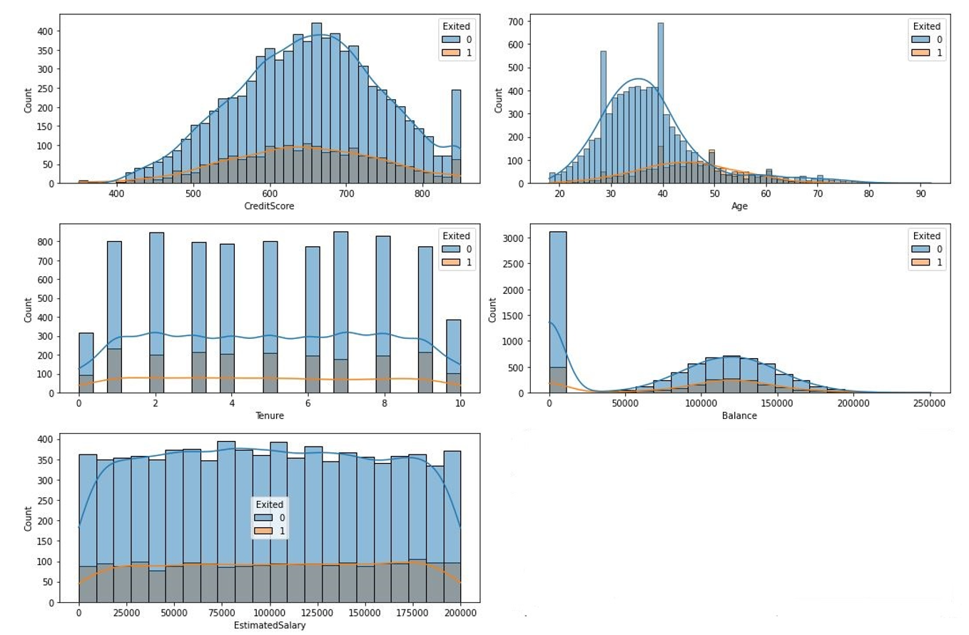
Numerical - Continuous Data

Slide 8
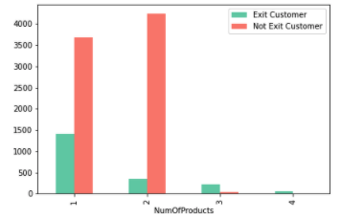
Numerical - Discrete Data

Slide 9
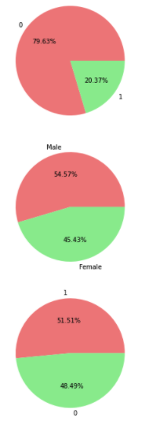
Categorical Data
EXITED CUSTOMER
GEOGRAPHY
GENDER
HAS CREDIT CARD
ACTIVE MEMBER

Slide 10
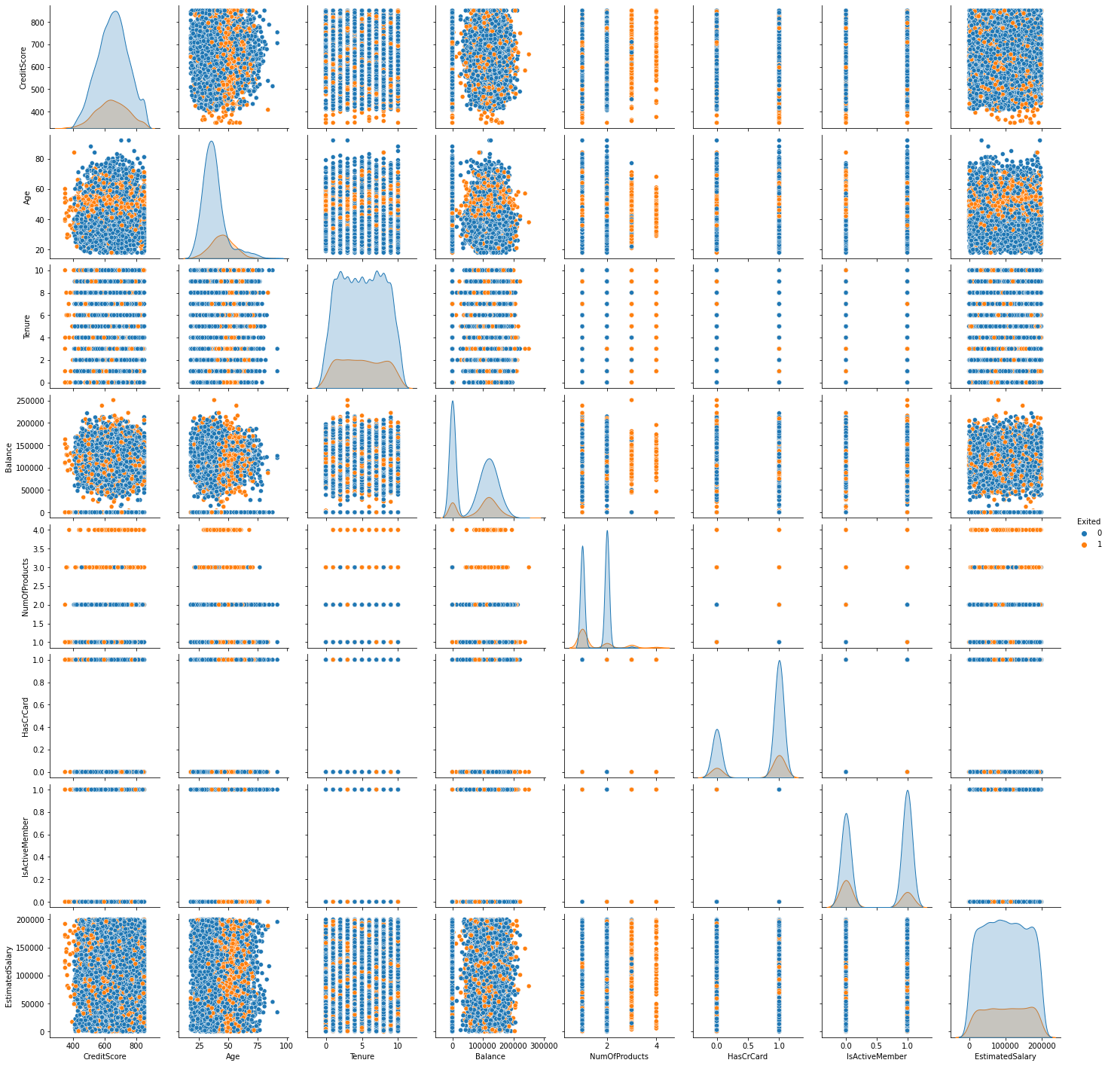
Data Correlations - Pairplot

Slide 11
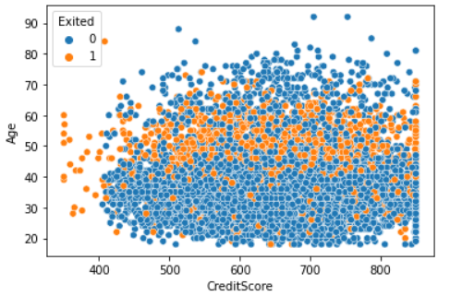
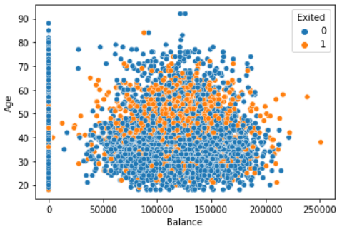
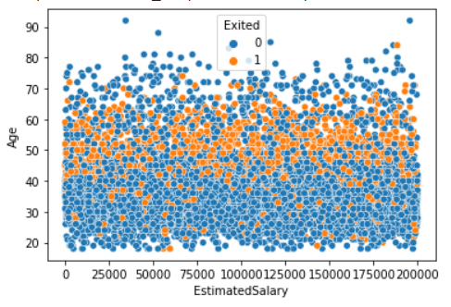
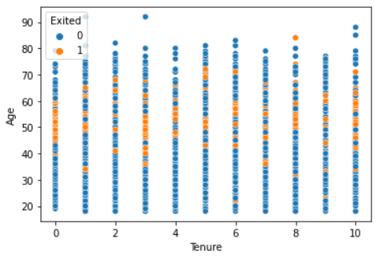
Data Correlations - Scatterplot

Slide 12
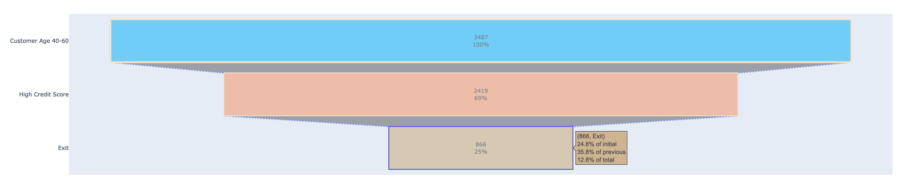
Insight and Recommendation
Customer with age 40-60 are tend to less engaged with our service, but we can retain some of them who have high credit score.

Slide 13
Stage 4
Data Preprocessing
Notes:
https://colab.research.google.com/drive/1rlGO6stgxkfK5VA43DG5gftyqavZFUn4

Slide 14
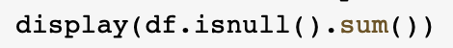
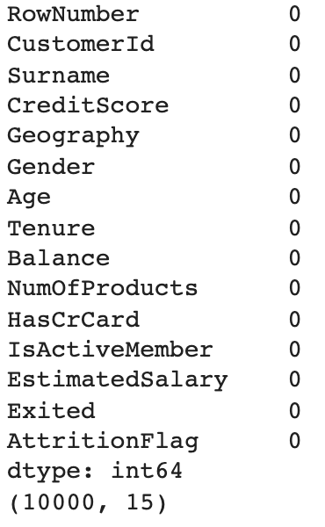
Handle Missing Values
Check missing or unknown values
No missing or null values found

Slide 15
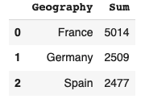
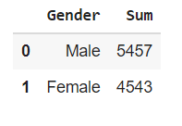
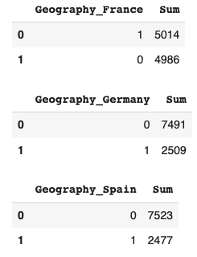
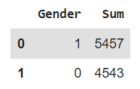
Encoding
Generate Encoding for Geography using ONE HOT ENCODING and Gender using LABEL ENCODING
GEOGRAPHY
GENDER
Before
After

Slide 16
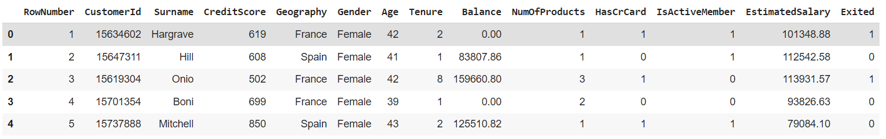
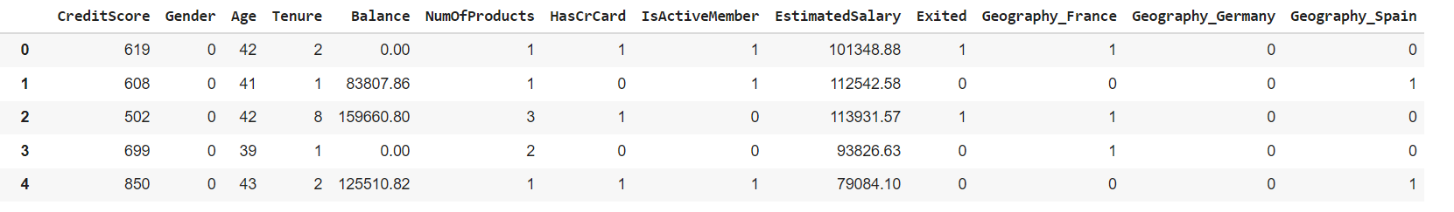
Data Preparation
Before
After

Slide 17
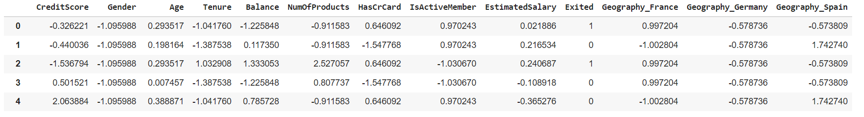
Standarization
Before
After

Slide 18
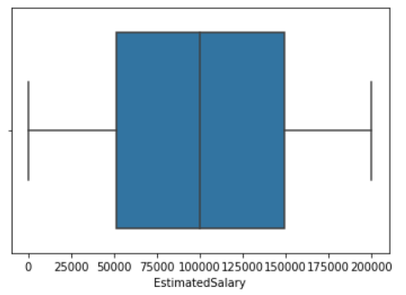
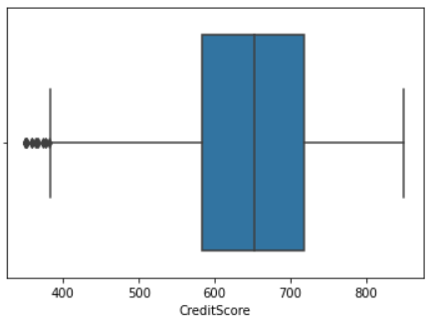
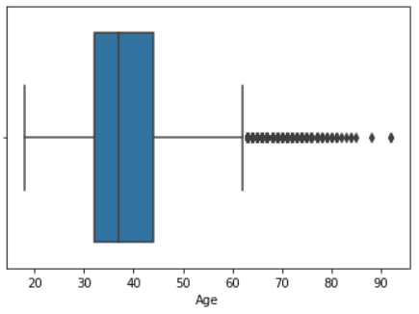
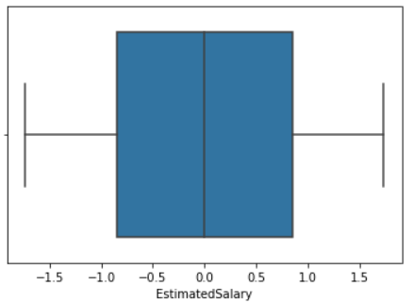
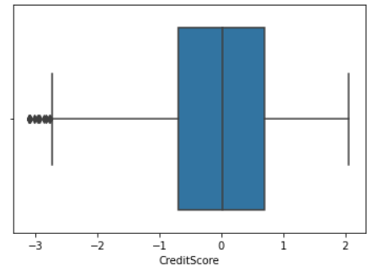
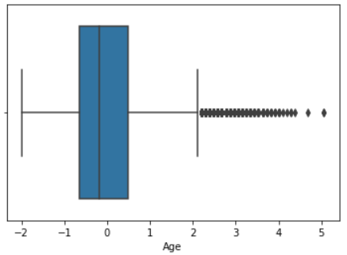
Scaling Comparison
ESTIMATED SALARY
CREDIT SCORE
AGE
Before
After

Slide 19
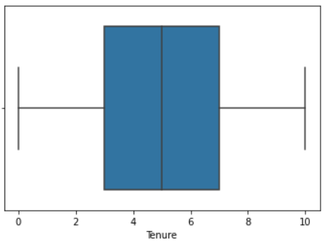
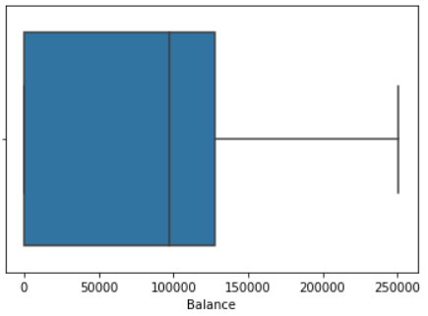
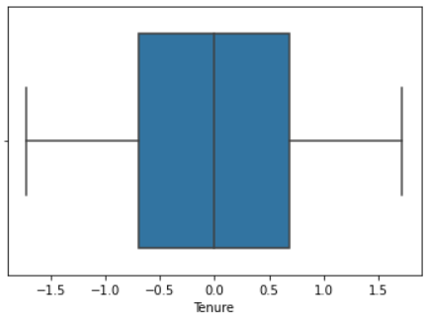
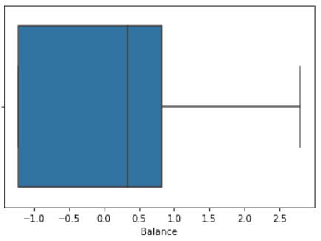
Scaling Comparison
TENURE
BALANCE
Before
After

Slide 20
Stage 5
Model, Evaluation, and Recommendation
Notes:
https://colab.research.google.com/drive/1rlGO6stgxkfK5VA43DG5gftyqavZFUn4

Slide 21
PROCESS
METHOD
Train Dataset (60%)
TRAIN-TEST SPLIT
Test Dataset (40%)
IMBALANCE DATASET
Over-sampling
Under-sampling
FEATURE SCALING
Standardization
Random Forest Classification
MODEL DEVELOPMENT
Logistic Regression
KNN
Cross Validation Test
HYPER TUNING PARAMETER
RandomizedSearchCV
Notes:
notes:
cobain feature selection
coba yg embed
untuk knn dan decision tree
coba kalo gak di sampling
coba sampling pake smote

Slide 22
RESULT & MODEL COMPARISON
Over-Sampling
Under-Sampling
Random Forest
Logistic Regression
K-Nearest Neighbors
Random Forest
Logistic Regression
K-Nearest Neighbors
Accuracy (%)
Accuracy (%)
Accuracy (%)
Accuracy (%)
Accuracy (%)
Accuracy (%)
82,38%
69,18%
78,90%
77,90%
69,40%
75,18%
Precision (%)
Precision (%)
Precision (%)
Precision (%)
Precision (%)
Precision (%)
73,18%
63,36%
67,03%
69,73%
63,46%
66,94%
Recall (%)
Recall (%)
Recall (%)
Recall (%)
Recall (%)
Recall (%)
76,24%
69,71%
66,32%
76,56%
69,81%
73,11%

Slide 23
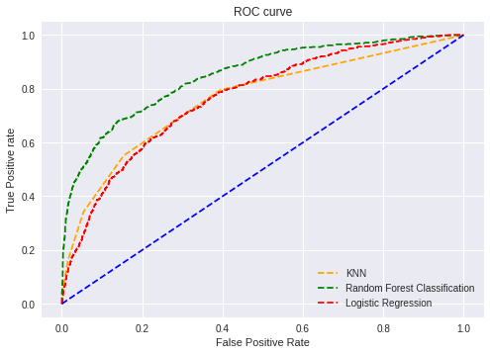
RESULT & MODEL COMPARISON
AUC Score
 | Base Model | Tuning | Under Sampling | Over Sampling
Random Forest Classification | 0,8460 | 0,8569 | 0,8561 | 0,8549
Logistic Regression | 0,7660 | 0,7663 | 0,7665 | 0,7668
KNN | 0,7558 | 0,7723 | 0,7723 | 0,6732
ROC Curve

Slide 24
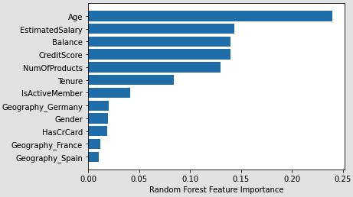
Insight & Recommendation
Feature Importance
1. We can predict churn customer by using age, estimated salary, balance, credit score and number of products they have.
2. For modelling we recommend to use Random Forest Classification

